Slide 1


DataBase Logic in Business Applications
Al.I. Cuza University of Iași
Faculty of Economics and Business Administration
Department of Accounting, Information Systems
and Statistics
Model Seeds and Patterns in Database Modeling (2)
By Marin Fotache & Co.

Slide 2
Notice
All the Oracle Data Modeler diagrams in this presentation are archived and can be downloaded at:
https://github.com/marinfotache/Database-Logic-in-Business-Applications/tree/master/05_Patterns%20in%20DB%20Logical%20Design
Please follow the instructions in `readme.txt` file

Slide 3
Seed Models and Patterns (part 2)
Trees & Hierarchies
Basic Tree
Overlapping Tree
Organizational Chart
Graphs
Basic Graph (A Single Route)
Routes (for trains, buses, etc.)
Timetables
Timetables & Journeys
Processes
Basic Process
Processes, skills required, budget
Workflow
Simple request flow
Request case progress

Slide 4
Basic Tree
Is a mathematical pattern
Can be applied in any situation when a hierarchy/subordination occurs
The hierarchy is rigid:
All entities (persons, deparments, ...) are nodes
A node can be subordinated to at most one node
There is (usually) one node which is not subordinated (this is the company's CEO)
The tree in the next slide keeps track of all changes in subordination relationships:
For nodes, the starting and ending moments are recoded (when the node occured/dissapeared)
A subordination relationship has an identifier, and also a start and a stop moments (when inforced/dissafected)

Slide 5
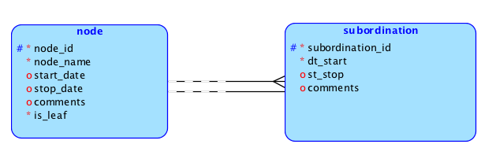
08a Basic Tree (With Temporal Validity)

Slide 6
Overlapping Tree
Based on 08a Basic Tree pattern
It is more practical, as a node can be simultaneously subordinated to two or more other nodes
As the hierarchy is not rigid, in entity subordonation an attribute is added – task_description -, which basically provides details about each relationship of subordination

Slide 7
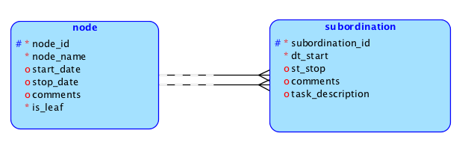
08b Overlapping Tree

Slide 8
Organizational Chart
The most common reification of Tree pattern
The hierarchy is not among people but among organizational entities (divisions, departments, teams, etc.)
For each entity a number of positions (roles) are defined (e.g. Chief Financial Officer, Assistant CFO, Cleaning & Maintenance, etc.) through entity attached_position; there are entities that require two or more identical positions (e.g. there are three PL/SQL Developer positions and two SQL junior positions in Database Development department )
Entity filled_position keep tracks of the employees that were hired on the attached positions, including the time period they filled that position
Works fine even for distributed organizations

Slide 9
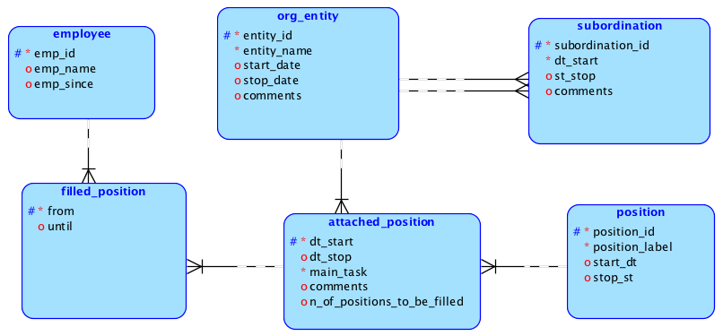
08c Organizational Chart

Slide 10
Graphs & Timetables
Graph is also a mathematical pattern
Graphs can be oriented or not
Graph Databases were designed to deal with such (connected) a type of information (see Polyglot Persistence and Big Data course)
Diagram in the next slide models a graph describing a single route
The graph is not oriented
Through entity arc is node is connected to its neighbours
An arc connect only two nodes (theoretically is can connect the same node, but here it is not the case)
For each arc, attribute distance keeps track of number of kilometers between the connected nodes
Temporal attributes are in use for both nodes and arcs

Slide 11
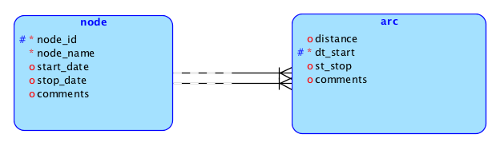
09a Basic Graph (A Single Route)

Slide 12
Routes
Stations are locations the trains or buses stop
Stations are related to cities
There is no limit in terms of number of stations in a city
Entity distance refers to the arcs linking two stations; attribute needed_minutes stores the number of minutes in which the distance is to be covered
Routes are paths (between two stations, departure and arrival) followed by the trains or buses
For each stop of the route main information are:
stop_no describes to order of the nodes (stations) within a route
minutes_from_departure records how many minuted are needed to cever the distance between the departure station (stop no.1) and the current stop; this is not (always) a computed attribute, since there are express buses/trains with fewer stops (and better engines)
distance_from_departure records the distance between the departure station (stop no.1) and the current stop; this is a redundant (computed) attribute

Slide 13
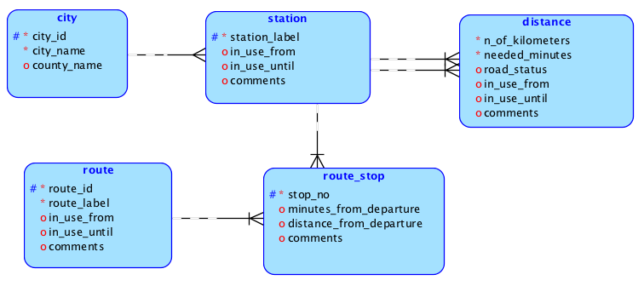
09b Routes (for trains, buses, etc.)

Slide 14
Timetables (bus/train schedulers)
Next slide diagram is appropriate for buses but can easily adapted for trains, airplanes, etc.
A timetable is in operation for a defined period of time
A timetable item is defined for a specific route and refers to general information about bus journeys (see departure_time)
Timetable items can operate daily, weekly or within customized intervals (entity irregular_tt_item)
For timetable items, one can declare periods of suspension (temporary cancellation) - for bad weather, repairs, etc.
Also if the schedule is different during holidays, one can use the entities fix_day_holiday, var_day_holiday and holiday_operation
A vehicle type is associated with each timetable item for knowing the number of passengers who can reserve tickes for specific journeys (journeys and reservations are not modeled here)
Entity timetable_detail correspunds to a journey stop; number of stop minutes can vary from timetable item to another

Slide 15
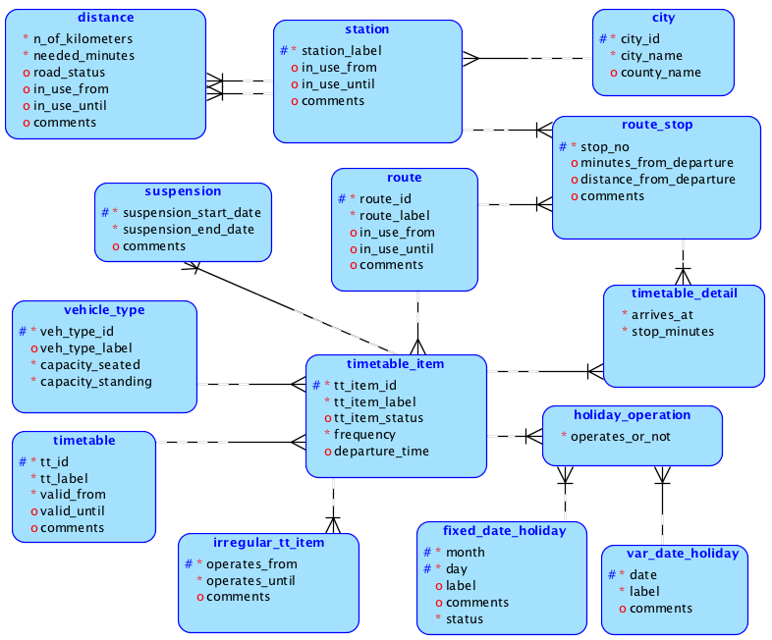
09c Timetables (for buses)

Slide 16
Journeys (Reservations/Tickets) & Timetables
?

Slide 17
Processes
Basic Process Template:
A process is divided into activities;
The same activity ca occur in many processes
Within a process, each activity is scheduled for a specific interval of time and is expected to be performed on a certain number of minutes
One or more employees can perform or coordinate every activity of the project; for each employee involved, her/his duties (tasks) are recorded
Processes, skills required, budget
Each process activity require a number of hours for a couple of skills; each skill cost a certain amount per hour
An employee has one or more skills
A process activity requires a certain amount of costs (estimated budget)
Real costs can differ from what was estimated

Slide 18
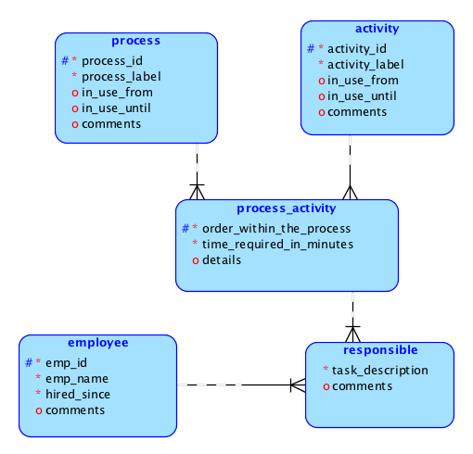
10a_Basic_Processes

Slide 19
10b_Processes_budget_skills
?

Slide 20
Workflows
Simple request flow:
A request is when a person demands a service, document, certificate (a new identity card, a copy of bachelor certificate or transcript of records, etc.) or the approval of a future action/process (transfer from a lecture group to another)
For each request, the flow is divided into stages (steps) to be covered sequentially (one by one)
Each stage is composed of certain activities (status check, approval, database/list updates, etc.)
For every stage activity, the positions in charge are recorded
Request case progress:
A person fills a request (of request type); this request becomes a case
A case must pass through all the stages defines for its request type
All employees (filled positions), their activities and resolutions involved in a case are recorded
At any moment a case status (progress) must be known

Slide 21
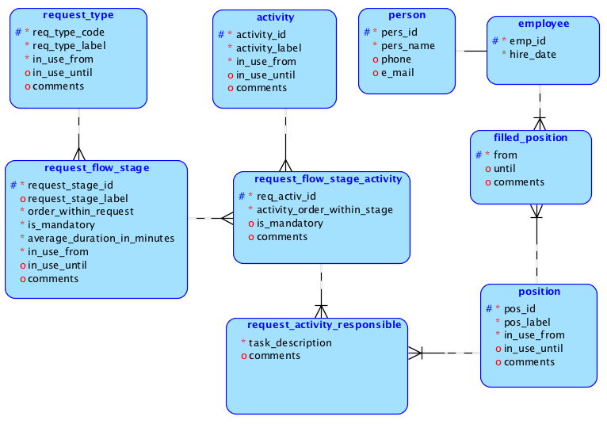
11a – Simple Request Flow

Slide 22
11b_Request_Cases_Progress
?

